Slide 1

G H Raisoni College of Engineering, Nagpur
Department of Information Technology
Project Seminar-II
(Session: 2023-2024)
Title of the Project:-“IPL Match Prediction
Using Machine Learning”
Presented By:
Shivam Narad (A-62)
Shrawil sarve (A-63)
Chetan Kumbhare (b-49)
Himanshu Dongare (b-59)
Guide:-
Prof. Ritu Pawar
GHRCE ,Nagpur

Slide 2
Introduction
The Indian Premier League (IPL) is one of the most popular and widely followed Twenty20 cricket leagues in the world. The unpredictability of cricket matches and the enormous fanbase make predicting match outcomes a fascinating challenge. This project aims to use machine learning techniques to predict IPL match results accurately, enhancing the excitement for cricket enthusiasts.

Slide 3
Objective
The objective of this project is to develop an efficient system for predicting the outcome of T20 cricket matches. Several factors, both in-game and pre-game, such as the venue, past team performance, and the outcome of the toss, play a significant role in determining the result of a match.
This project also places a strong emphasis on conducting in-depth exploratory data analysis, building predictive models, and creating data visualizations related to the Indian Premier League (IPL). To achieve the best possible match outcome prediction, a variety of methods will be employed, including supervised machine learning using a Random Forest Classifier and statistical techniques.
Additionally, to ensure convenient access and usability of the predictions, the project intends to deploy a user-friendly web application that is compatible with various web browsers.

Slide 4
Hardware /Software Specification
Hardware:
GPU would be better
Processor: Intel Core i3 or above
Ram: 4 GB Minimum
Disk Space: 2 GB Minimum
Software:
Python 3 or above (packages like numpy, matplotlib, seaborn, pandas and sklearn)
For Web Application Streamlit app framework
Operating System: Windows 7 or above

Slide 5
Literature Survey
Daniel Mago Vistro, Faizan Rasheed, Leo Gertrude David et al [1] the target of this research was to predict the match winner of IPL using historical data of IPL from season 2008 to 2017. SEMMA methodology has been selected for conducting the analysis of IPL T20 match winner dataset. Preprocessing has been done on the dataset to form it consistent by removing missing value, encoding variables into numerical format. Best features were selected by visualizing attributes of knowledge with target variable. On selected features several machine learning models has been applied on the to predict the winner and therefore the results were outstanding. Decision Tree model was applied which predicted the match winner with good accuracy 76.9%.
Rabindra Lamsal & Ayesha Choudhary et al [2] It includes the varied factors that influence the result of an Indian Premier League matches were identified. The seven factors which significantly influence the results of an IPL match include the house team, the away team, the toss winner, toss decision, the stadium, and therefore the respective teams’ weight. Hence designing machine learning model for predicting the match outcome of an auction based 2020 format premier league with the accuracy of 72.66% & F1 score of 0.72 is very satisfactory at this stage.

Slide 6
Literature Survey
Rameshwari Lokhande et al [3] The problem of churning is addressed by using interactive models of Predictions where a user predicts the results of each game in order to be rewarded which would further help him strengthen his Fantasy squad. The project thus, aims not only to attract more users to this game that is Fantasy Cricket, but also aims at improving the general attraction to the Premier League. This happens because in a predictive model, a user makes a prediction on every game, and ends up watching that game to check if his prediction is going right.
Siddharth Sinha et al [4] This model is employed for predicting the result of the match supported historic data. During the extraction of features various features has been involved but most vital features has been taken during prediction. They also made a team structure in terms of slots which defines most vital slots contributing to match winning and a ranking system for the players through their performance statistics. They used K-means to cluster all players consistent with their performance and KNN (K-nearest neighbor) is employed to seek out interchangeable player to a specific player. SVM model was trained using linear, polynomial and RBF (Radial Basis function). Thus, they preferred SVM with RBF kernel for prediction.

Slide 7
Proposed Model
PROPOSED APPROACH
By implementing a Random Forest model and enhancing the feature selection or featurisation, we have potentially build a more accurate and robust predictor for IPL match outcomes.
Finally, we used Streamlit Framework for frontend for the model generated. So that a person can enter information into a web application and receive a prediction of win percentage of the team.

Slide 8
Proposed Model
We developed a web application that can predict whether the input message is spam or ham(legitimate). We began by defining the problem and gathering information. Then we worked on data preparation, exploration, modeling, and evaluation of the models. Finally, we created the frontend website using streamlit framework for the model. So that the user can input data and check whether input message is ham or spam.

Slide 9
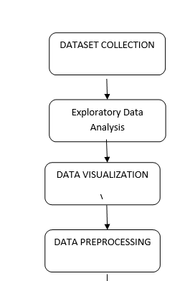
Proposed Model

Slide 10
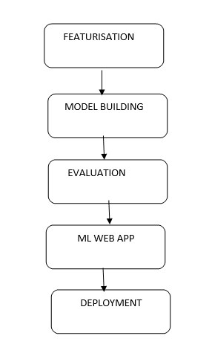
Proposed Model

Slide 11
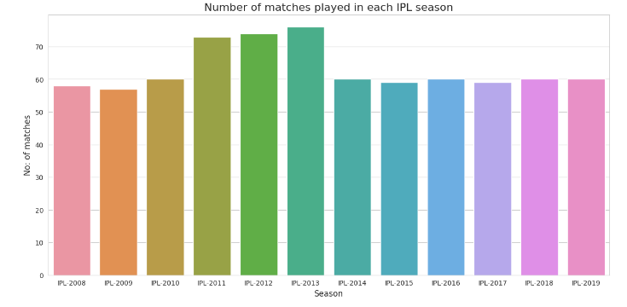
EDA SOME SCATTERPLOTS
Most number of matches were played in IPL-2013 Season

Slide 12
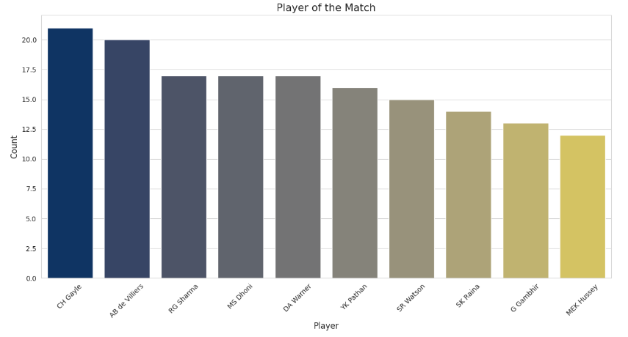
EDA SOME SCATTERPLOTS
Most Man of the Match Titles Won Player

Slide 13
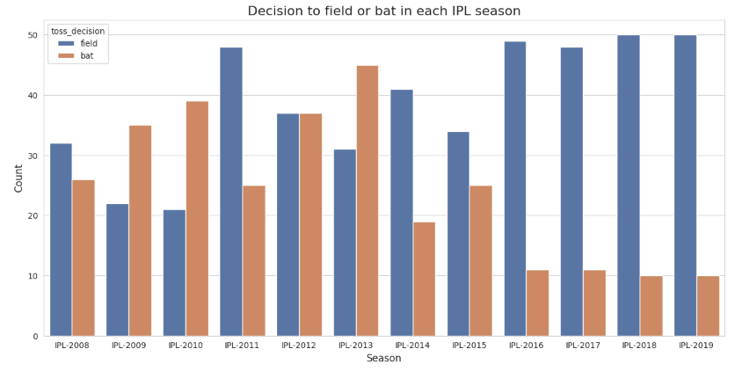
EDA SOME SCATTERPLOTS
We can see a trend that, decisions to field are more from IPL-2016 Season

Slide 14
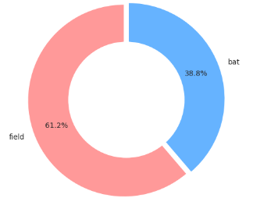
EDA SOME SCATTERPLOTS
In more than 61% of matches, teams chose to field after winning the toss

Slide 15
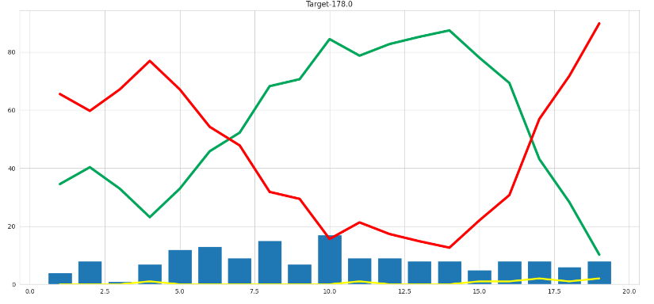
EDA SOME SCATTERPLOTS
A graph to visualize the match's progress, including wickets, win probability, and lose probability.

Slide 16
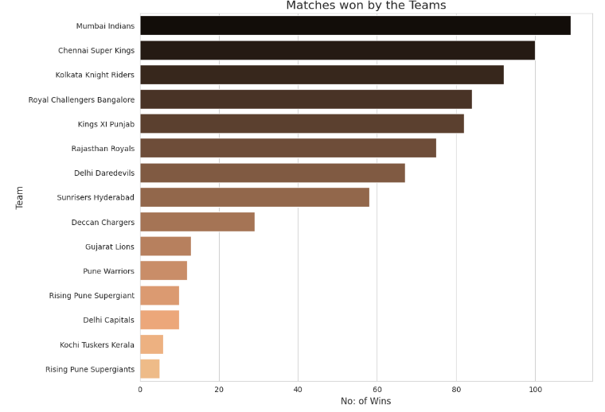
EDA SOME SCATTERPLOTS
Mumbai Indians won most number of matches followed by Chennai Super Kings

Slide 17


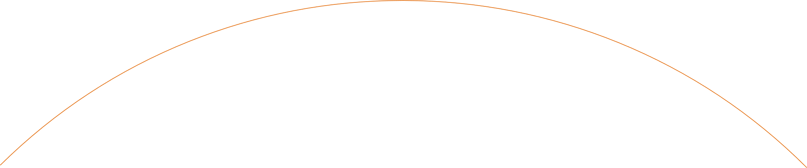

Work Division
Work Division
Chetan Kumbhare
Shivam
Narad
Handled the data preprocessing part
Helped in implementing the ML Models
Himanshu
Dongre
Shrawil
Sarve
Handled the documentation
Also helped in NLP Part.
Handled the NLP Part.
Also did some data preprocessing
Decided which ML Models to use.
Analyzed the accuracies of the models.

Slide 18
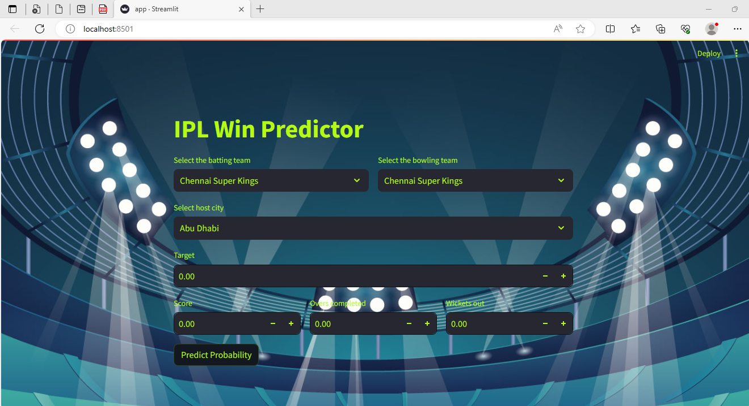
Frontend

Slide 19
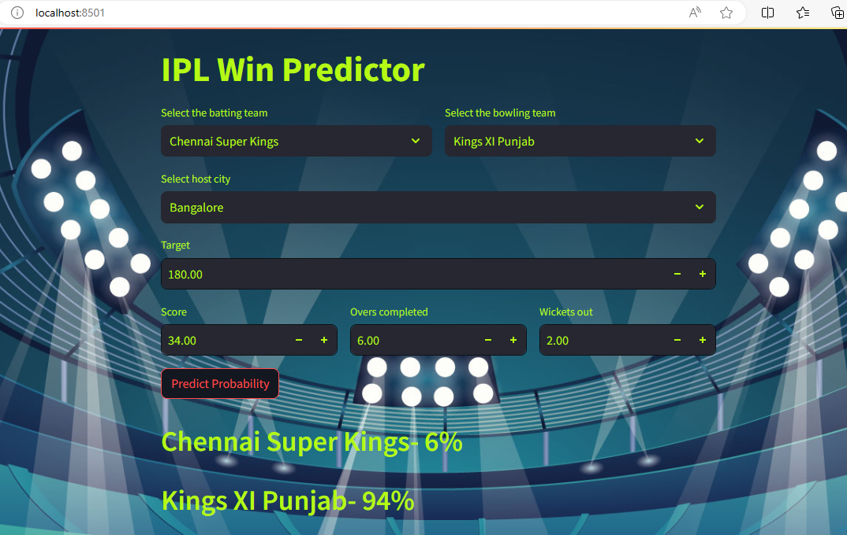
OUTPUT:

Slide 20
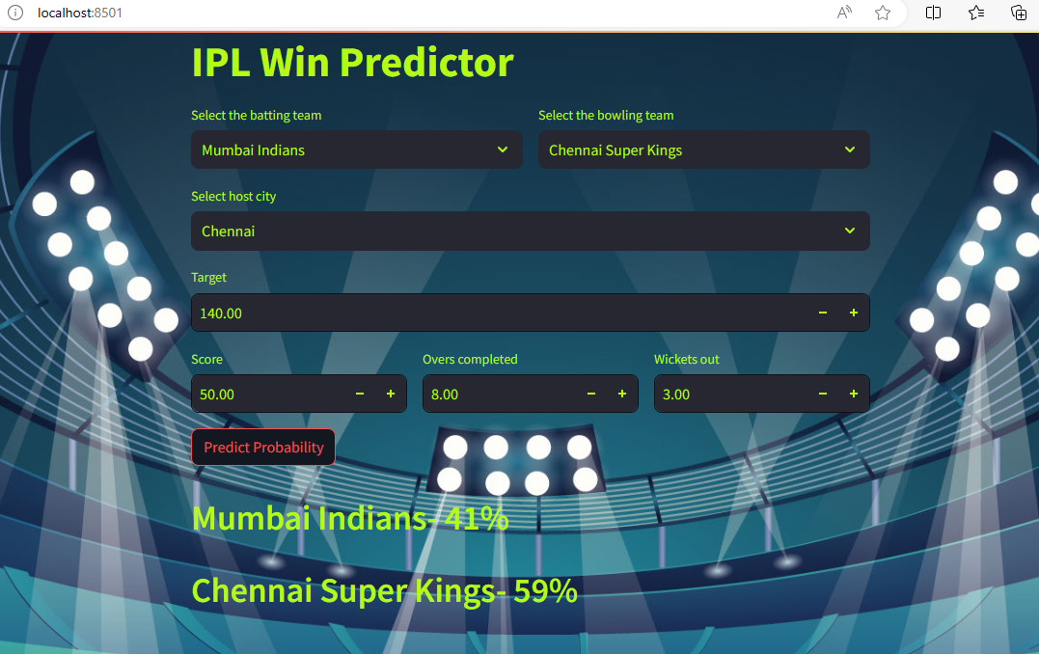
OUTPUT:

Slide 21
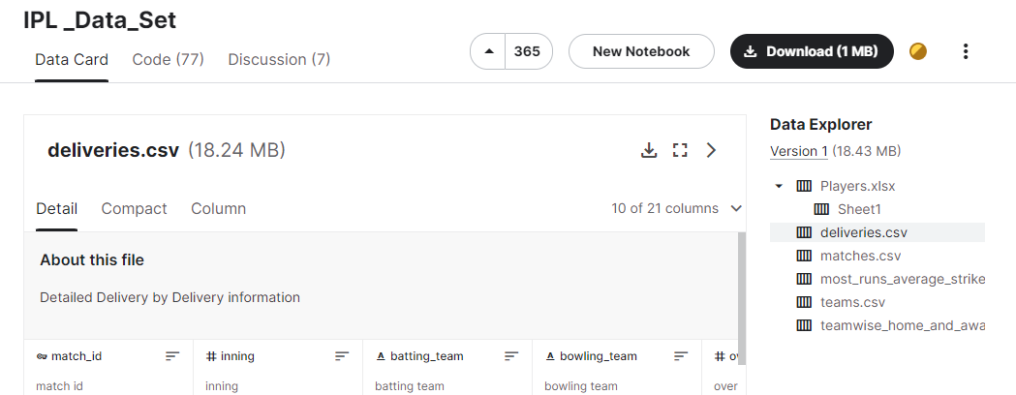
Data Collection
Data set has been collected from Kaggle.com
(https://www.kaggle.com/datasets/ramjidoolla/ipl-data-set)

Slide 22
Conclusion
In this project, 10 to 11 machine learning algorithms are used to predict Email sms Spam detection: Support Vector Machine, Random Forest, Ada Boost, Gradient Boosting, Logistic Regression, and Decision Tree Classifier etc.
The accuracy of each algorithm is compared to determine which one is best suited for the prediction.
The best algorithm for prediction is the Multinomial Naive bayes, which has a pinpoint prediction accuracy [on "UCI learning dataset repository for Spam Messages Collections"].
As a result, combining our Multinomial Naive bayes algorithm and the attributes of this dataset, Spam messages may be predicted with near-perfect accuracy.
Hence Web application is using Multinomial Naive bayes algorithm model via Pickle file for prediction on Website.

Slide 23
Reference
Daniel Mago Vistro, Faizan Rasheed, Leo Gertrude David “Cricket winner prediction with application of machine learning and data analytics” IJSTR Volume 8, Issue 09, September 2019.
Rabindra Lamsal and Ayesha Choudhary “Predicting Outcome of Indian Premier League (IPL) Matches Using Machine Learning” ResearchGate (2020)
Rameshwari Lokhande “Prediction of live cricket score and winning” IJRTD Volume 5(4), (2018).
Siddharth Sinha “IPL Win Prediction System To Improve Team Performance using SVM” IJFGCN Vol. 13, (2020)
Sanjay Gupta, Hitesh Jain, Asmit Gupta and Hemant Soni, “Fantasy League Team Prediction”, International Journal of Research in Science and Engineering, Vol. 6, No. 3, pp. 97- 103, 2017.

Slide 24
Reference
6) 13) Pabitra Kumar Dey, Gangotri Chakraborty, Purnendu Ruj and Suvobrata Sarkar, “A Data Mining Approach on Cluster Analysis of IPL”, International Journal of Machine Learning and Computing, Vol. 2, No. 4, pp. 351-354, 2012.
7) Raza Ul Mustafa, M. Saqib Nawaz, M. Ikram Ullah Lali, Tehseen Zia and Waqar Mehmood, “Predicting the Cricket Match outcome using Crowd Opinions on Social Networks: A Comparative Study of Machine Learning Methods”, Malaysian Journal of Computer Science, Vol. 30, No. 1, pp. 63-76, 2017.
8) Jayshree Hajgude, Aishwarya Parameshwaran, Krishna Nambi, Anupama Sakhalkar and Darshil Sanghvi, “IPL Dream TeamA Prediction Software Based on Data Mining and Statistical Analysis”, International Journal of Computer Engineering and Applications, Vol. 9, No. 4, pp. 113-119, 2015.

Slide 25
Thank You…..

